Slide 1
FLYWIRE
Future-State
Implementation Blueprint
ONE
MODEL
Customer
Quote
Contract
Revenue
Clean data model, governed data flow, service design, controls and delivery roadmap
Team discussion deck • August 2026
Notes:
[Sources]
- C:/Users/LIKKI/Downloads/Flywire Future State Vision_20260814 (1).pdf, pages 4-10
- C:/Users/LIKKI/Documents/ChatGPT/david/force-app/main/default
[/Sources]

Slide 2
IMPLEMENTATION BLUEPRINT
A single operating model connects customer, quote, contract and revenue data
The implementation is organized around one governed commercial record chain. Every downstream process consumes the same validated data instead of reconstructing meaning in each system.
CUSTOMER
OPPORTUNITY
QUOTE
CONTRACT
ORDER
REVENUE
1
1
1
0
governed customer identity
quote-to-contract lifecycle
reconciled revenue view
silent downstream handoffs
Flywire future-state implementation
02
Notes:
[Sources]
- C:/Users/LIKKI/Downloads/Flywire Future State Vision_20260814 (1).pdf, pages 5-6 and 18
[/Sources]

Slide 3
IMPLEMENTATION BLUEPRINT
The blueprint covers all three transformation initiatives in one design
01
02
03
UNIFIED FOUNDATION
QUOTE TO CASH
CONTRACT LIFECYCLE
• Golden customer and hierarchy
• One product and pricing model
• Governed integration events
• Single reporting definitions
• Guided configuration
• Tier, ramp and term pricing
• Risk-based approvals
• ARR, MRR and TCV
• Proposal and order handoff
• Contract creation and repository
• Clause, approval and signature
• Account/entity association
• Obligation and status reporting
• Renewal and amendment controls
Shared controls: identity • security • audit • data quality • release governance • reconciliation
Flywire future-state implementation
03
Notes:
[Sources]
- C:/Users/LIKKI/Downloads/Flywire Future State Vision_20260814 (1).pdf, pages 6-10
[/Sources]

Slide 4
IMPLEMENTATION BLUEPRINT
Six principles keep the data model, services and process states synchronized
01
Single source of truth
02
Configuration over branching
03
State drives behavior
Each business concept has one authoritative owner and one stable key.
Pricing and approval policies live in governed rules, not scattered code.
Editability, approvals, documents and handoffs depend on explicit lifecycle states.
04
Events carry correlation
05
Metrics use one engine
06
Controls ship with features
Every downstream message can be retried, traced and reconciled.
ARR, MRR, TCV and one-time revenue share versioned calculation inputs.
Security, audit, tests and rollback are part of every capability.
Flywire future-state implementation
04
Notes:
[Sources]
- C:/Users/LIKKI/Downloads/Flywire Future State Vision_20260814 (1).pdf, pages 18 and 39-46
- C:/Users/LIKKI/Documents/ChatGPT/david/force-app/main/default
[/Sources]

Slide 5
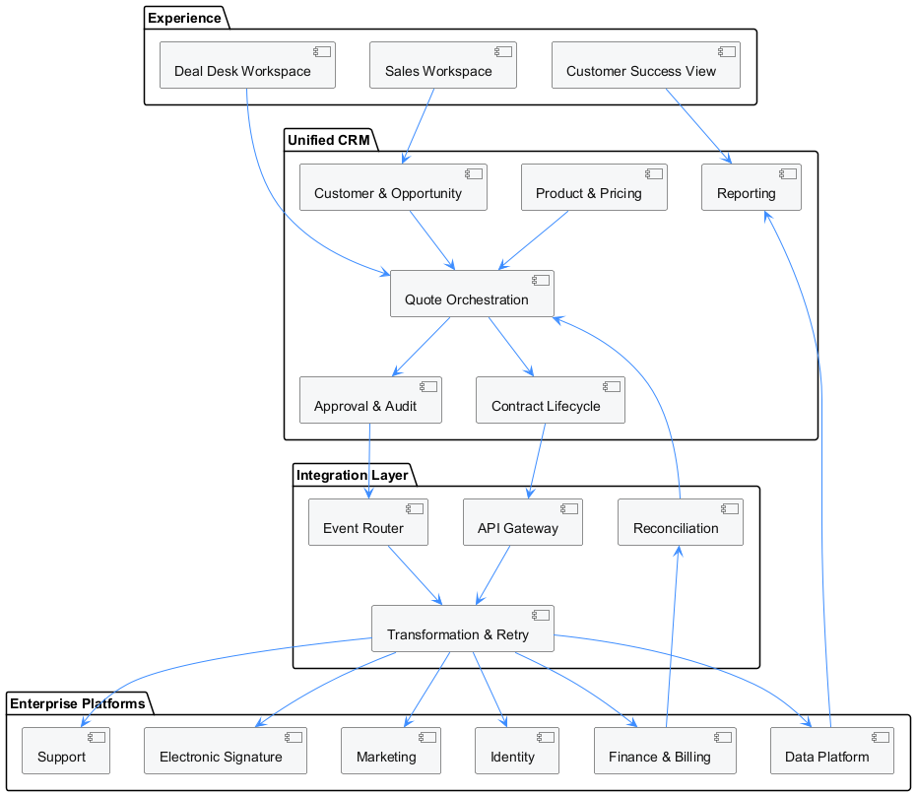
IMPLEMENTATION BLUEPRINT
The target architecture separates experience, orchestration, integration and enterprise platforms
WHY THIS SHAPE
• One CRM experience for sales, deal desk and customer success
• Orchestration owns commercial process; integrations do not
• Integration layer handles transformation, retry and correlation
• Finance acknowledgements flow back into reconciliation
• Reporting consumes governed CRM and data-platform definitions
Design rule
No point-to-point integration may silently change the commercial meaning of a record.
Flywire future-state implementation
05
Notes:
[Sources]
- C:/Users/LIKKI/Downloads/Flywire Future State Vision_20260814 (1).pdf, pages 18, 48-49
- C:/Users/LIKKI/Documents/ChatGPT/david/tmp/flywire_future_deck/integration_architecture.puml
[/Sources]

Slide 6
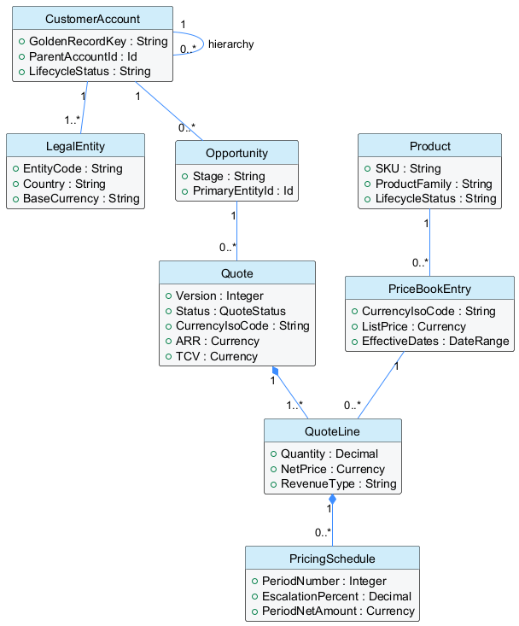
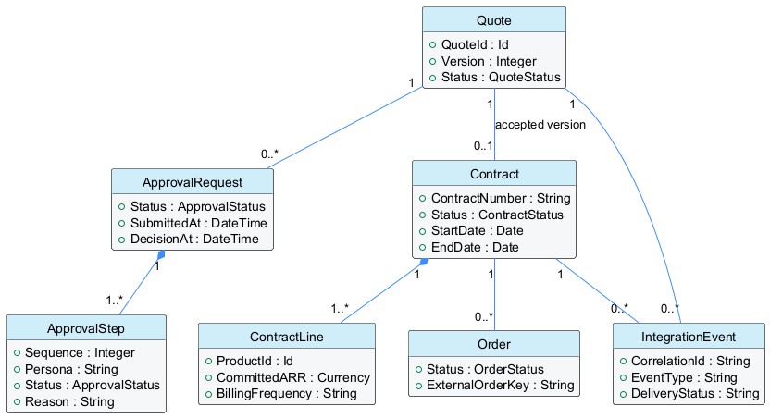
IMPLEMENTATION BLUEPRINT
The canonical model gives each commercial concept one governed home
COMMERCIAL CONFIGURATION
APPROVAL, CONTRACT AND EXECUTION
PlantUML source is included in the implementation working set
06
Notes:
[Sources]
- C:/Users/LIKKI/Downloads/Flywire Future State Vision_20260814 (1).pdf, pages 18, 23-31 and 39-46
- C:/Users/LIKKI/Documents/ChatGPT/david/tmp/flywire_future_deck/data_model_commercial.puml
- C:/Users/LIKKI/Documents/ChatGPT/david/tmp/flywire_future_deck/data_model_execution.puml
[/Sources]

Slide 7
IMPLEMENTATION BLUEPRINT
Ownership rules prevent duplicate truth and uncontrolled updates
DOMAIN
AUTHORITATIVE RECORD
OWNER
KEY CONTROL
Customer
CustomerAccount + LegalEntity
CRM data steward
Golden key, hierarchy and match policy
Product
Product + PriceBookEntry
Product operations
SKU uniqueness, eligibility and effective dates
Commercial
Quote + QuoteLine + PricingSchedule
Sales / deal desk
Version, state, approval and edit locks
Contract
Contract + ContractLine
Legal / commercial operations
Accepted terms, entity and obligation integrity
Order
Order + IntegrationEvent
Operations
Correlation, acknowledgement and retry status
Revenue
RevenueMetrics + financial actuals
Finance
Versioned formula and variance reconciliation
Every integration reads from an authoritative record and writes only through an owned service or approved reconciliation path.
Flywire future-state implementation
07
Notes:
[Sources]
- C:/Users/LIKKI/Downloads/Flywire Future State Vision_20260814 (1).pdf, pages 18 and 41-46
[/Sources]

Slide 8
IMPLEMENTATION BLUEPRINT
Data moves forward only after validation and controlled decisions
IDENTIFY
CONFIGURE
CALCULATE
DECIDE
COMMIT
RECONCILE
Match customer
and entity
Select product
and price
Schedule value
and metrics
Validate and
approve
Generate, sign
and contract
Order, bill
and compare
CONTROL GATES
01
Identity
02
Commercial policy
03
Approval
Golden account, hierarchy and legal entity are resolved.
Product, pricing, term, risk and completeness pass.
Required personas decide; material values remain locked.
04
Acceptance
05
Reconciliation
Proposal and contract reference the approved quote version.
Downstream acknowledgement and financial variance are recorded.
Flywire future-state implementation
08
Notes:
[Sources]
- C:/Users/LIKKI/Downloads/Flywire Future State Vision_20260814 (1).pdf, pages 23-31
- C:/Users/LIKKI/Documents/ChatGPT/david/tmp/flywire_future_deck/data_flow.puml
[/Sources]

Slide 9
IMPLEMENTATION BLUEPRINT
One quote state model governs edits, approvals, documents and downstream handoffs
DRAFT
CONFIGURED
VALIDATED
APPROVED
PROPOSAL
CONTRACTED
ORDERED
ACTIVATED
PENDING APPROVAL
Required after validation when policy thresholds are triggered
AMENDMENT
Material change returns to validation and approval
STATE GUARANTEES
Draft permits editing • Pending Approval locks commercial values • Proposal references an immutable approved version • Contracted and Ordered require acknowledged handoffs
Status is behavior—not a label.
Flywire future-state implementation
09
Notes:
[Sources]
- C:/Users/LIKKI/Downloads/Flywire Future State Vision_20260814 (1).pdf, pages 23, 28-31
- C:/Users/LIKKI/Documents/ChatGPT/david/tmp/flywire_future_deck/state_model.puml
[/Sources]

Slide 10
IMPLEMENTATION BLUEPRINT
Approval rules are configuration, not hard-coded branching
RULE INPUT
EVALUATION
CONTROLLED ACTION
• Rule key and effective dates
• Active flag and priority
• Discount / ARR / term thresholds
• Product, entity and currency scope
• Risk and exception categories
• Required persona and sequence
• Parallel-group identifier
• Human-readable reason template
Quote Context
• Create approval request
• Resolve approvers by persona
• Lock commercial values
• Record each decision
• Notify only required participants
• Recall or reject with reason
• Unlock through controlled transition
• Retain audit history
+
Active Rules
↓
Approval Plan
ordered steps • parallel groups • reasons • missing approvers
Phase 1 can run in evaluation-only mode before submission is enabled.
Flywire future-state implementation
10
Notes:
[Sources]
- C:/Users/LIKKI/Downloads/Flywire Future State Vision_20260814 (1).pdf, pages 23-26
- C:/Users/LIKKI/Documents/ChatGPT/david/force-app/main/default
[/Sources]

Slide 11
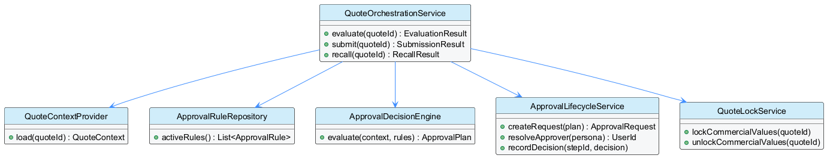
IMPLEMENTATION BLUEPRINT
Approval services isolate policy decisions from lifecycle execution
Context
Decision
Lifecycle
Build one immutable view of quote, line, customer and risk inputs.
Evaluate active rules and produce an explainable approval plan.
Create requests, lock values, record decisions and preserve audit.
Flywire future-state implementation
11
Notes:
[Sources]
- C:/Users/LIKKI/Downloads/Flywire Future State Vision_20260814 (1).pdf, pages 23-26
- C:/Users/LIKKI/Documents/ChatGPT/david/tmp/flywire_future_deck/approval_class_diagram.puml
[/Sources]

Slide 12
IMPLEMENTATION BLUEPRINT
Pricing schedules and revenue metrics share one versioned calculation model
CATALOGUE
PRICE BOOK
PRICING RULE
QUOTE LINE
SCHEDULE
METRICS
Product, bundle, eligibility
Currency, list price, dates
Tier, ramp, term, exception
Quantity and net price
Period-level amount
ARR, MRR, TCV, one-time
CALCULATION CONTRACT
OUTPUT AND RECONCILIATION
• Inputs are captured with quote-version and rule-version identifiers
• Schedules preserve escalation and ramp-period detail
• One-time lines never distort recurring metrics
• Currency conversion uses an explicit rate date and source
ARR = normalized recurring value
MRR = recurring value ÷ service months
TCV = sum of all scheduled contract value
Variance = contracted metric − financial actual
Flywire future-state implementation
12
Notes:
[Sources]
- C:/Users/LIKKI/Downloads/Flywire Future State Vision_20260814 (1).pdf, pages 23-26 and 43
- C:/Users/LIKKI/Documents/ChatGPT/david/force-app/main/default
[/Sources]

Slide 13
IMPLEMENTATION BLUEPRINT
Product governance separates catalogue, price, packaging and eligibility
SELLABLE EXPERIENCE
Guided selection • compatible options • customer-friendly labels
PACKAGING
Bundles • required/optional components • product relationships
PRICING
Price books • currency • effective dates • tier/ramp/term rules
CATALOGUE
SKU • product family • lifecycle • billing and revenue classification
GOVERNANCE
Owner • approval • data quality • release and audit
New products enter through a governed lifecycle—not through direct production edits.
Flywire future-state implementation
13
Notes:
[Sources]
- C:/Users/LIKKI/Downloads/Flywire Future State Vision_20260814 (1).pdf, pages 23-26, 33 and 43
- C:/Users/LIKKI/Documents/ChatGPT/david/force-app/main/default
[/Sources]

Slide 14
IMPLEMENTATION BLUEPRINT
Proposal generation consumes the same approved quote model
APPROVED QUOTE
NORMALIZED DATA
TEMPLATE
RENDERED PROPOSAL
SIGNED ARTIFACT
Immutable version
Approved values
Customer + groups
Lines + schedules
Conditional sections
Reusable fragments
Client-facing terms
Clear price schedules
Envelope status
Content hash
Document controls
Template version • input schema version • quote version • generation timestamp • content hash • signature envelope • retention policy
Flywire future-state implementation
14
Notes:
[Sources]
- C:/Users/LIKKI/Downloads/Flywire Future State Vision_20260814 (1).pdf, pages 23-26
- C:/Users/LIKKI/Documents/ChatGPT/david/force-app/main/default
[/Sources]

Slide 15
IMPLEMENTATION BLUEPRINT
Contract lifecycle begins with accepted structured data—not a document upload
01
02
03
04
05
ACCEPT
CREATE
VALIDATE
ACTIVATE
MONITOR
Capture signature and accepted quote version
Create contract and line records with legal entity
Verify dates, currency, products and obligations
Publish order and billing events
Track obligations, actuals, renewal and amendments
Minimum contract data quality gate
Account and entity match • accepted terms • contract dates • currency • products • recurring value • obligations • source quote version
Flywire future-state implementation
15
Notes:
[Sources]
- C:/Users/LIKKI/Downloads/Flywire Future State Vision_20260814 (1).pdf, pages 28-31 and 43
[/Sources]

Slide 16
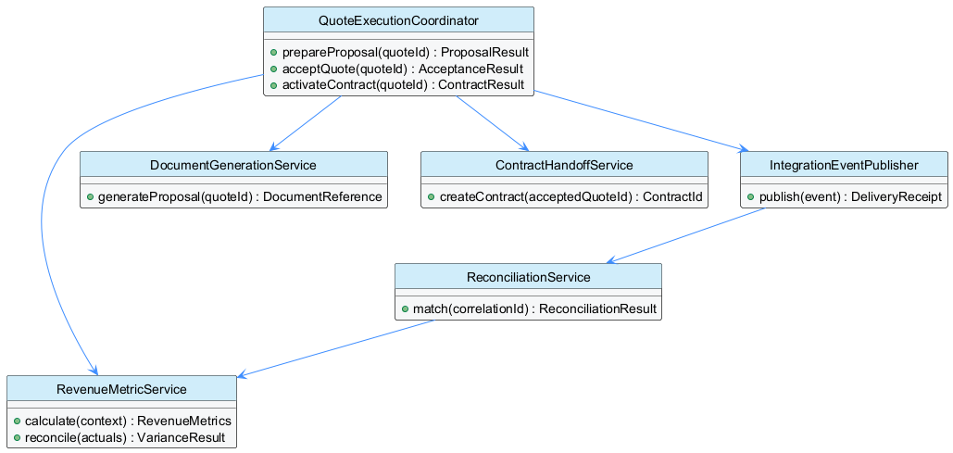
IMPLEMENTATION BLUEPRINT
Execution services preserve traceability through contract activation
Generate
Handoff
Reconcile
Proposal and signature are tied to one quote version.
Contract and integration events carry stable correlation identifiers.
Financial actuals are matched back to contracted metrics.
Flywire future-state implementation
16
Notes:
[Sources]
- C:/Users/LIKKI/Downloads/Flywire Future State Vision_20260814 (1).pdf, pages 28-31 and 49
- C:/Users/LIKKI/Documents/ChatGPT/david/tmp/flywire_future_deck/execution_class_diagram.puml
[/Sources]

Slide 17
IMPLEMENTATION BLUEPRINT
Integration events are idempotent, observable and reconcilable
CRM CHANGE
OUTBOX EVENT
TRANSFORM
DELIVER
ACK
RECONCILE
Identity
Correlation ID, source record ID and event version
Delivery
Idempotency key, retry count and terminal status
Contract
Schema version, required fields and validation result
Evidence
Payload hash, timestamp, actor and response reference
Flywire future-state implementation
17
Notes:
[Sources]
- C:/Users/LIKKI/Downloads/Flywire Future State Vision_20260814 (1).pdf, pages 18 and 48-49
[/Sources]

Slide 18
IMPLEMENTATION BLUEPRINT
Security and governance are built into every state transition
01
02
03
04
05
ACCESS
DATA
PROCESS
INTEGRATION
AUDIT
Persona-based permissions
Least privilege
Segregation of duties
Field classification
Encryption and retention
Golden-record stewardship
State-based edit locks
Approval authority
Controlled amendments
Named authentication
Schema validation
Replay protection
Decision reasons
Payload hashes
Correlation and lineage
Release governance
One source repository • isolated capability packages • automated tests • check-only validation • business UAT • controlled activation • rollback evidence
Flywire future-state implementation
18
Notes:
[Sources]
- C:/Users/LIKKI/Downloads/Flywire Future State Vision_20260814 (1).pdf, pages 18, 40 and 46
- C:/Users/LIKKI/Documents/ChatGPT/david/force-app/main/default
[/Sources]

Slide 19
IMPLEMENTATION BLUEPRINT
Salesforce implementation components align directly to business capabilities
CAPABILITY
CONFIGURATION
SERVICE / AUTOMATION
EVIDENCE
Customer foundation
Match rules, hierarchy fields
Account identity service
Duplicate and hierarchy reports
Product & pricing
Catalogue, price books, pricing rules
Pricing and schedule service
Rule-version calculation log
Quote approval
Approval rule metadata, personas
Decision, lifecycle and lock services
Approval request, steps and reasons
Proposal
Template and schema versions
Document generation service
Document reference and content hash
Contract
Contract types, obligations, clauses
Contract handoff service
Quote-to-contract lineage
Integration
Endpoint and event configuration
Publisher, retry and reconciliation
Delivery receipt and variance result
Naming standard: capability + responsibility. Legacy organization-specific names are not carried forward.
Flywire future-state implementation
19
Notes:
[Sources]
- C:/Users/LIKKI/Downloads/Flywire Future State Vision_20260814 (1).pdf, pages 23-31 and 41-46
- C:/Users/LIKKI/Documents/ChatGPT/david/force-app/main/default
[/Sources]

Slide 20
IMPLEMENTATION BLUEPRINT
Delivery moves from evidence to pilot to scalable operating model
0–6 WEEKS
7–16 WEEKS
4–8 MONTHS
8–12 MONTHS
DESIGN
PILOT
SCALE
CONSOLIDATE
Confirm process, data definitions, ownership, rules, vendor boundaries and acceptance criteria.
Build evaluation-only approval, metric engine, controlled proposal and one integration path.
Enable approval lifecycle, contract handoff, reconciliation and broader product/entity coverage.
Migrate remaining users/data, rationalize integrations and establish one release model.
Pilot success gate: explainable approvals + stable metrics + approved document + acknowledged downstream handoff
Flywire future-state implementation
20
Notes:
[Sources]
- C:/Users/LIKKI/Downloads/Flywire Future State Vision_20260814 (1).pdf, pages 10, 21, 26 and 31
[/Sources]

Slide 21
IMPLEMENTATION BLUEPRINT
Quality gates prove data, logic and integration integrity before activation
01
MODEL
02
RULES
Required entities, keys, ownership and lifecycle states are approved.
Boundary values, overlaps, missing approvers and effective dates are tested.
03
METRICS
04
SECURITY
ARR, MRR, TCV and one-time revenue reconcile across test scenarios.
Personas can perform only authorized actions in each state.
05
INTEGRATION
06
BUSINESS UAT
Retry, duplicate delivery, schema failure and acknowledgement paths are proven.
Sales, deal desk, legal, finance and operations accept end-to-end outcomes.
Flywire future-state implementation
21
Notes:
[Sources]
- C:/Users/LIKKI/Downloads/Flywire Future State Vision_20260814 (1).pdf, pages 21, 26 and 31
- C:/Users/LIKKI/Documents/ChatGPT/david/force-app/main/default
[/Sources]

Slide 22
IMPLEMENTATION BLUEPRINT
The first 30 days convert this blueprint into an approved implementation backlog
WEEK 1
WEEK 2
WEEK 3
WEEK 4
Confirm ownership
Validate the model
Define pilot rules
Approve the backlog
Name accountable owners for customer, product, quote, contract, integration and metrics.
Map existing fields and records to the canonical model; identify duplicates and gaps.
Select approval, pricing, metric and document scenarios for the first controlled pilot.
Agree components, acceptance criteria, test data, release gates and decision log.
Decisions required from the team
Pilot segment • source-of-truth owners • approval personas • metric definitions • contract boundary • integration priority • success measures
Flywire future-state implementation
22
Notes:
[Sources]
- C:/Users/LIKKI/Downloads/Flywire Future State Vision_20260814 (1).pdf, pages 10, 21, 26 and 31
[/Sources]

